Slide 1
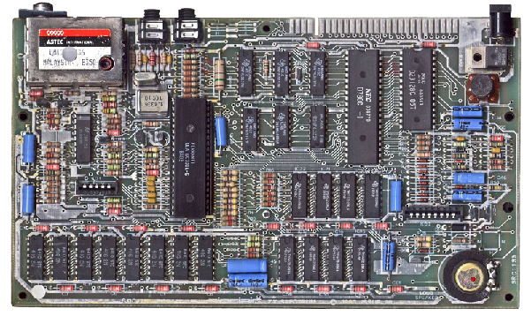


ENGR 151
An (accelerated) introduction to computers and programming
Lecture 1: Introduction to course and MATLAB
Notes:
Introduction
‘introductory’ - start from scratch
‘accelerated’ - advanced stuff, important piece is OOP : object oriented programing

Slide 2
Contents
Overview of ENGR 151
Introduction to Computing CARES
Speaking to a computer
The MATLAB environment

Slide 3
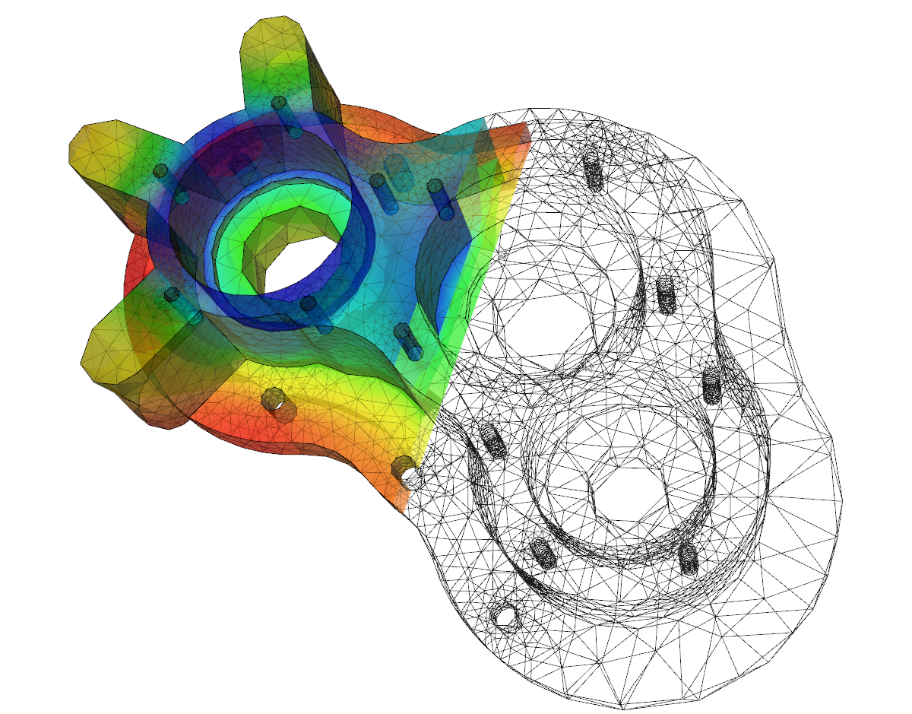
What is ENGR 151?
ENGR 151 is a class about solving real world problems by programming computers.
This is a course for everyone:
We assume no prior programming experience
BUT… compared to ENGR101, we will move faster and include more advanced topics
Notes:
Projects of real world problems
Designing a dam
Radiation therapy: treatment planning software
Calculating rocket trajectory
K-means clustering - unsupervised machine learning technique
Radioactive decay
How to heat a room with space-heaters? Heat transport
Physics/math simple / how to write it into codes so that computer can help solve it.

Slide 4
Acknowledgement
The lectures, labs and projects in this course are heavily based on those taught by Prof. Alec Thomas in the past few years. Creation of such materials involves tremendous amount of work, which is highly acknowledged by the current teaching team.

Slide 5
Languages we will use
C++ is a very popular general-purpose compiled language that can be used for all aspects of computing. It is a language to use to learn lower level operations of a computer.
MATLAB is a high-level interpreted language that is suited for many scientific and engineering applications. It also provides graphical output with a minimum of effort.
Notes:
Lower level - closer to computer
Higher level - closer to matlab
matrix multiplication

Slide 6
Basic structure of ENGR151
Part I
(8 lectures / 4 laboratories)
Introduction to programming with MATLAB
Part II
(8 lectures / 4 laboratories)
Introduction to programming with C++
Part III
(8 lectures / 4 laboratories)
Advanced projects involving C++ and MATLAB

Slide 7
Philosophy of the Course
We will start with some syntax - this is NOT that important
You will have a “cheat sheet” for your exams
An ‘impression’ of fundamentals in programming has more value
“It is a course in thinking, technical thinking, logical thinking, about formulating a problem, a mathematical problem, a physics problem, a game, and then, executing a solution and making it work.” from Prof. Alex Bielajew’s textbook
Notes:
‘impression’ - what data types does Matlab or C++ support?
There are so many languages in the world.
Understand physics -> formulate the math model -> writing code to solve it -> debug/verify solution

Slide 8


Coding in Lecture
We'll often work on coding exercises during lecture, so you may want to bring a laptop or tablet with you to class.
Make sure it is charged - there are no outlets in the lecture theatre.
Please feel free to share a laptop with your neighbors.

Slide 9
Computing Laboratories
… take what you learned in lecture and put it into practice
Laboratories generally include:
Review of lecture material
An interactive exercise
Hands-on coding practice
Notes:
Lab arrangement (Friday / Monday / Tuesday)
avoid a situation that some students already got scores and the solution while others still working on it.

Slide 10
Contents
Overview of ENGR 151
Introduction to Computing CARES
Speaking to a computer
The MATLAB environment

Slide 11
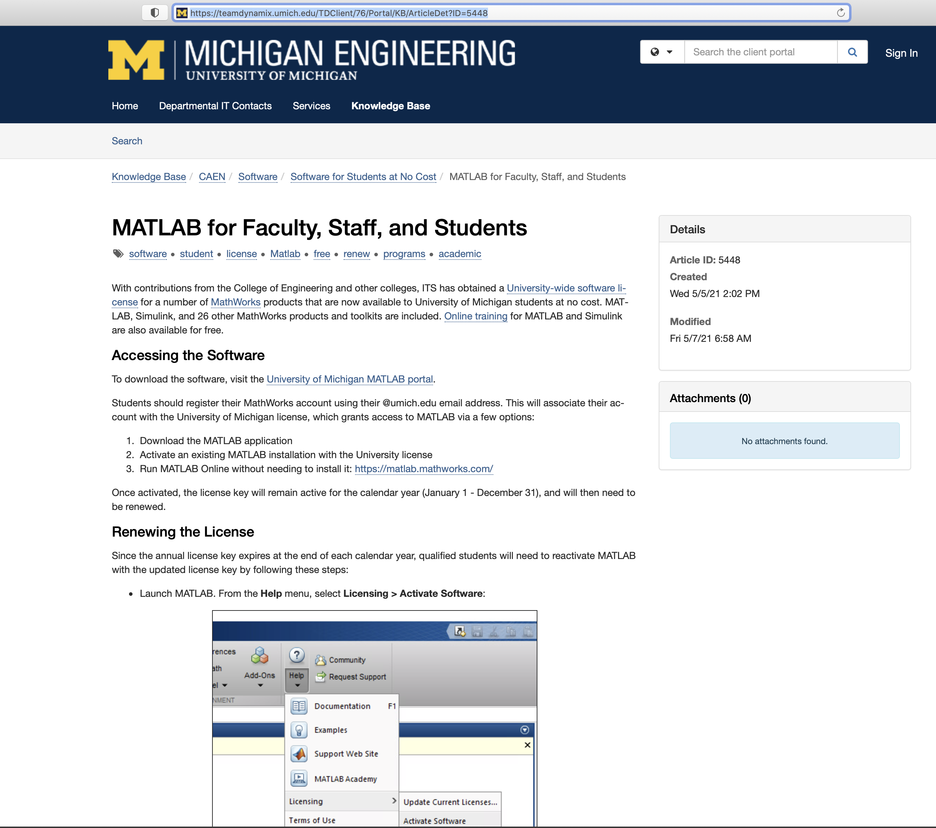
Obtaining MATLAB: Free for UM students (University wide license)
https://teamdynamix.umich.edu/TDClient/76/Portal/KB/ArticleDet?ID=5448

Slide 12
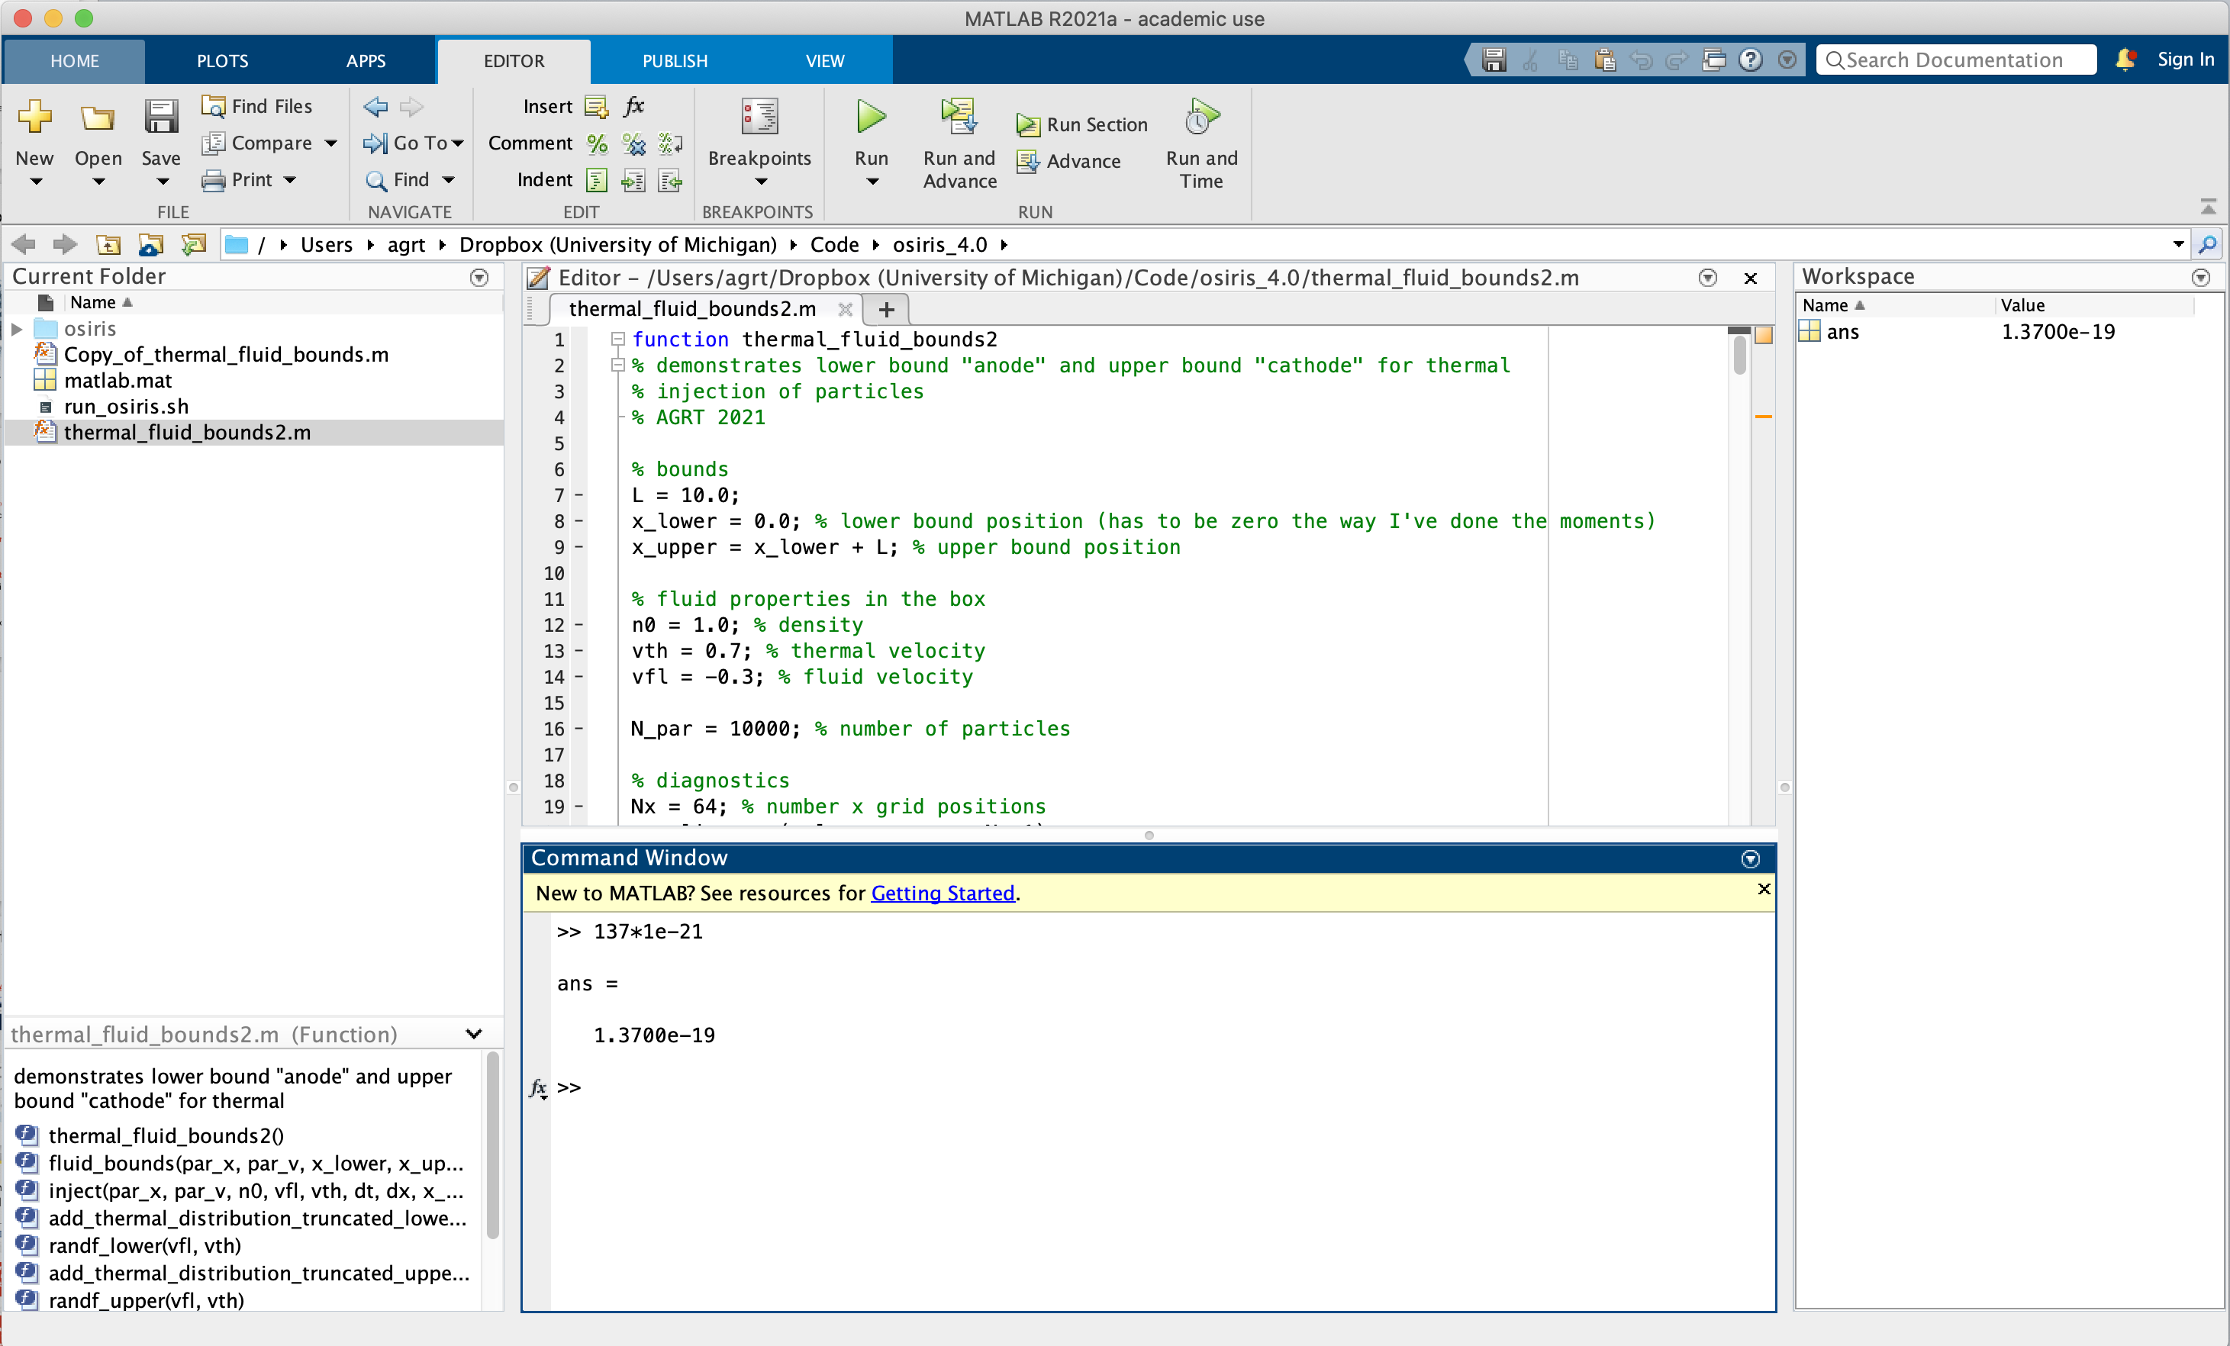
MATLAB is an interactive programming environment suited for solving problems in a variety of scientific and engineering disciplines.
Script/Function Editor
Write code here, either as a script or function, to be run later.
Current Folder
Your files live here. You probably want a new one for each project.
Workspace
This is your window into the program's memory.
Command Window
Interactively type programs here. MATLAB executes the code when you hit enter. Output is also shown here.
Notes:
Students should be familiar with this after seeing lab 1, so this slide is essentially like a high level review.
Make sure to point out that the interface is customizable, so theirs may have different windows in different places.
Command window: execute when hitting enter (line by line)
Script editor: write multiple lines and run them together later

Slide 13
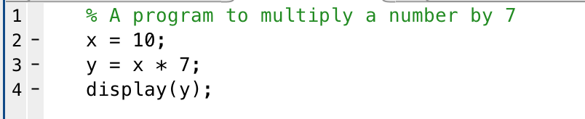
MATLAB Programming
STATEMENT
A program is a sequence of statements that give instructions for the computer to execute.
Generally, we write each statement on its own line.
There are two ways to execute MATLAB programs:
Interactively: Type statements at the command window. When you hit Enter, MATLAB executes them immediately.
From a script: Prepare a sequence of statements ahead of time and run them later.
STATEMENT
STATEMENT
STATEMENT
Notes:
Open matlab, type in these commands. A sequence of instruction to the computer makes a program

Slide 14
Reading a MATLAB Program
This program sets a number, multiplies it by 7, then displays the result.
The first line is a comment… MATLAB comments start with a %
Comments are essential to help understand the code
The fourth line is an example of a function call.
It displays the value of y
Notes:
Discuss each line and run

Slide 15
Read/Eval/Display Loop
The MATLAB interpreter processes input (from keyboard or scripts) as follows:
read the next statement
a command, assignment, or expression
execute the statement, evaluating expressions as needed
if an assignment or expression stmt, display the result
unless statement ends in semicolon (;)
Read
Display
Evaluate
Notes:
semicolon suppresses display

Slide 16
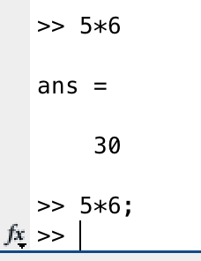
Semicolons suppress output
Unlike C++, not ending a line with a semicolon is not an error; it just outputs the result of the expression

Slide 17
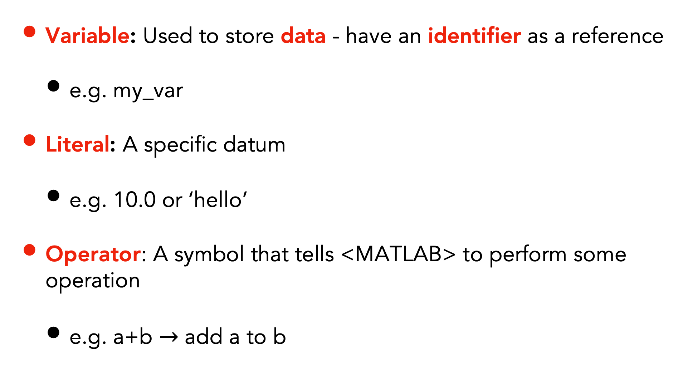
Some definitions
Variable: Used to store data - have an identifier as a reference
e.g. my_var
Literal: A specific datum
e.g. 10.0 or ‘hello’
Operator: A symbol that tells <MATLAB> to perform some operation
e.g. a+b $→$ add a to b
In MATLAB variable names (identifiers) may contain letters, numbers, or _. They must start with a letter and are case sensitive (e.g. myVar is different from myvar)
ENGR 101 1/13/19
Notes:
Test other symbols
Test case sensitive
Test keyword as variable name

Slide 18
Types
MATLAB supports a number of data types
e.g. integers, floating point, logical etc.
It is weakly typed, which means you don’t have to declare the type of the data
The default type is double precision floating point
Notes:
numeric default: double floating point
can use class() to show variable type

Slide 19
Scalar Operations
The following operations are defined between two scalars:
+ addition
- negation, subtraction
* multiplication
/ “right” division (divided by e.g. 10 / 5 is 2)
\ “left” division (divided into e.g. 5 \ 10 is 2)
^ exponentiation (e.g. 5 ^ 2 is 25)

Slide 20
Some definitions
Assignment: Sets the value of a variable on the LHS of the = operator to the value from an expression on the RHS
e.g. y = x
In MATLAB, the assignment of a variable for the first time is also its declaration where the data type is established - see later
Function: A piece of code that takes input data and converts it to output data that is called by its identifier
e.g. sin(x)
Expression: A literal or identifier
e.g. 1.0 or x or sin(x)

Slide 21
Some definitions
Compound expression: Formed by combining expressions with operators
e.g. x + (y+1)
Precedence: The order in which operators are applied to expressions
e.g. ( ) first, = last

Slide 22
Mathematical Operator Precedence
The order of operations is important:
( ) parenthesis
^ exponentiation
- negation
*, /, \ all multiplication and division
+, - addition and subtraction

Slide 23
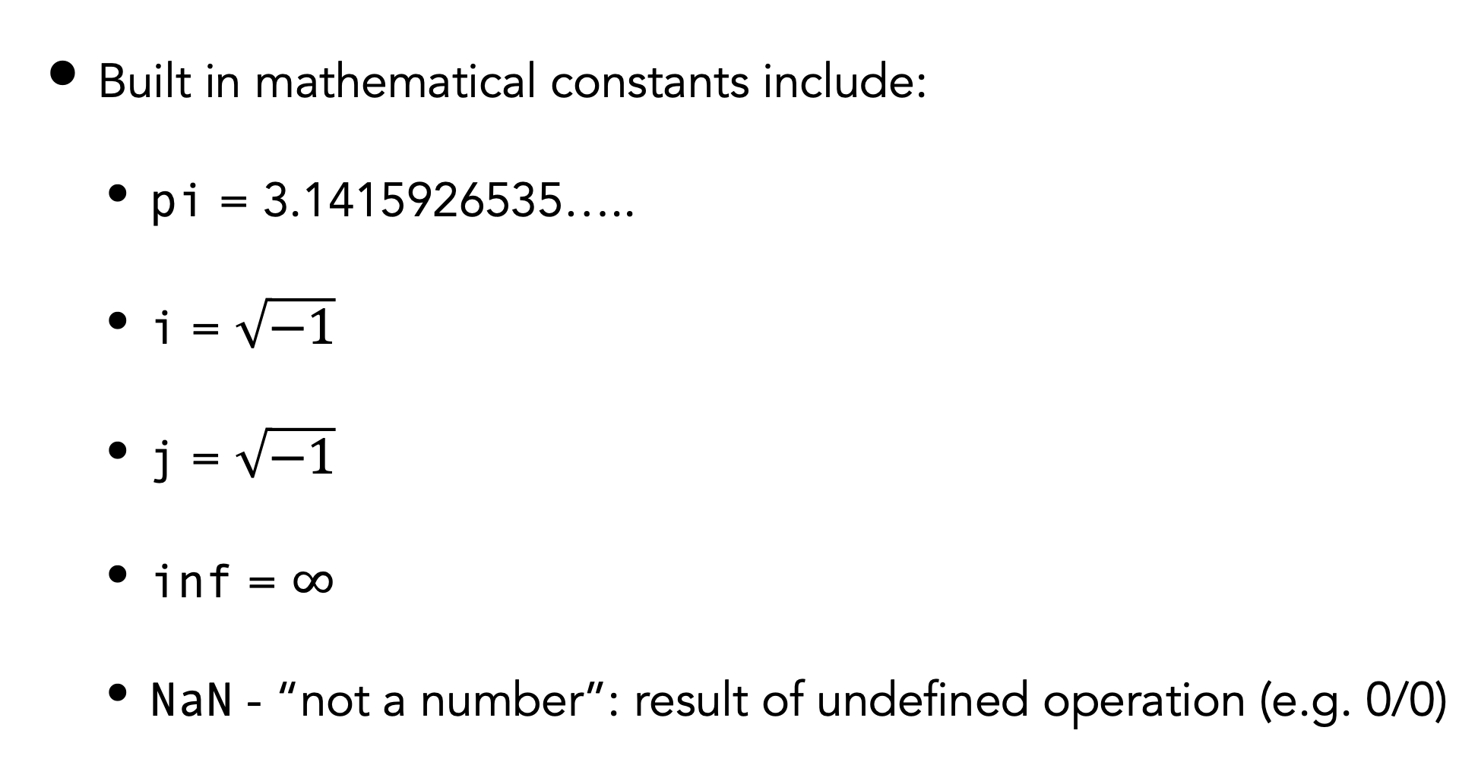
MATLAB constants
Built in mathematical constants include:
pi = 3.1415926535…..
i = $\sqrt{−1}$
j = $\sqrt{−1}$
inf = $∞$
NaN - “not a number”: result of undefined operation (e.g. 0/0)
Notes:
home - preferences - command window, can change digits of numeric format in command window

Slide 24
Built-in MATLAB Functions
There are a large number of predefined mathematical functions in MATLAB.
Trigonometric Functions (all inputs are in radians):
sin(x) sine
cos(x) cosine
tan(x) tangent
asin(x) arcsine
acos(x) arccos
atan(x) arctan
Other Math Functions
abs(x) absolute value
exp(x) ex
log(x) natural log of x
mod(x,y) mod function (remainder)
sqrt(x) square root

Slide 25
More Useful MATLAB Functions
max(A) returns the max value in A
min(A) returns the min value in A
sum(A) sums all the values in A
For max( ), min( ), and sum( ):
If A is a vector, returns a scalar.
If A is a matrix, returns a vector of column maxs/mins/sums.
ceil(x) Rounds up (ceiling)
floor(x) Rounds down
fix(x) Rounds towards zero
round(x) Rounds to nearest integer
input(‘Message’) Prompts for user input using ‘Message’
There are many, many others…
Notes:
best way: check documentation when using

Slide 26
Next lecture
MATLAB: Vectors, Matrices and Functions

